Slide 1

UI Customization
For Cityworks 15.4
Trainer: Brandon Whitney

Slide 2
Course Objectives
Introduce basic XML layout and structure.
Explain best practices in UI customization.
Demonstrate simple XML-based customizations.
Demonstrate injection of HTML, CSS, and JavaScript into XML.

Slide 3
Extensible Markup Language (XML)
Uses tags and elements to structure, manipulate, and describe data.
Similar tag and element structure to HTML.
Used in Cityworks to generate HTML (Layout Manager). Benefits:
Very shallow learning curve.
Easy interfacing with HTML, CSS, and JavaScript.
Customizations are simple and immediate.

Slide 4
XML Terminology
Tag: The beginning or ending of an element, enclosed in angle brackets.
Element: Everything between matching tags. Corresponds with an object on a page.
Markup: String between tags to format the elements.
Content: String between tags that is not markup.
Attributes: Strings inside of tags to modify certain features of an element.
<label id=“label_cboDescription”>
<text>
<![CDATA[
<css class=“item”>Type</css>
]]>
</text>
</label>

Slide 5
XML Terminology
Tag: The beginning or ending of an element, enclosed in angle brackets.
Element: Everything between matching tags. Corresponds with an object on a page.
Markup: String between tags to format the elements.
Content: String between tags that is not markup.
Attributes: Strings inside of tags to modify certain features of an element.
<label id=“label_cboDescription”>
<text>
<![CDATA[
<css class=“item”>Type</css>
]]>
</text>
</label>

Slide 6
XML Terminology
Tag: The beginning or ending of an element, enclosed in angle brackets.
Element: Everything between matching tags. Corresponds with an object on a page.
Markup: String between tags to format the elements.
Content: String between tags that is not markup.
Attributes: Strings inside of tags to modify certain features of an element.
<label id=“label_cboDescription”>
<text>
<![CDATA[
<css class=“item”>Type</css>
]]>
</text>
</label>

Slide 7
XML Terminology
Tag: The beginning or ending of an element, enclosed in angle brackets.
Element: Everything between matching tags. Corresponds with an object on a page.
Markup: String between tags to format the elements.
Content: String between tags that is not markup.
Attributes: Strings inside of tags to modify certain features of an element.
<label id=“label_cboDescription”>
<text>
<![CDATA[
<css class=“item”>Type</css>
]]>
</text>
</label>

Slide 8
XML Terminology
Tag: The beginning or ending of an element, enclosed in angle brackets.
Element: Everything between matching tags. Corresponds with an object on a page.
Markup: String between tags to format the elements.
Content: String between tags that is not markup.
Attributes: Strings inside of tags to modify certain features of an element.
<label id=“label_cboDescription”>
<text>
<![CDATA[
<css class=“item”>Type</css>
]]>
</text>
</label>

Slide 9
XML File Structure in Cityworks
All XML files must begin with an XML Declaration:
<?xml version=“1.0” encoding=“utf-8” ?>
Flag for Cityworks Layout Manager:
<webLayout xmlns=“http://www.azteca.com/cityworks/layout/webLayout” >
Lets Layout Manager know how to handle it.
Controls: <controls>…</controls>
Layout: <layout>…</layout>
Messages: <messages>…</messages>

Slide 10
Controls
Section used to define and configure each control element:
Buttons, grids, text boxes, drop-downs, calendars, check boxes, and radio buttons.
Cityworks layout manager follows certain naming conventions for control IDs:
“cbo_____” for drop-downs. Example: “cboDescription”
“cal_____” for calendars. Example: “calActualFinishDate”
“grd_____” for grids.
“chk_____” for check boxes.
“txt_____” for text boxes.
“btn_____” for buttons.
Tags for elements will vary depending on type: Grid, Button, Control

Slide 11
Layout
Arranges elements on the page.
Pages divided into columns, panels, and rows.
Columns and panels have IDs, rows have an index for position within the panel.
Page division limits:
Three columns per page
Unlimited panels per column
Unlimited rows per panel.
For a panel to display, must have row with content.

Slide 12
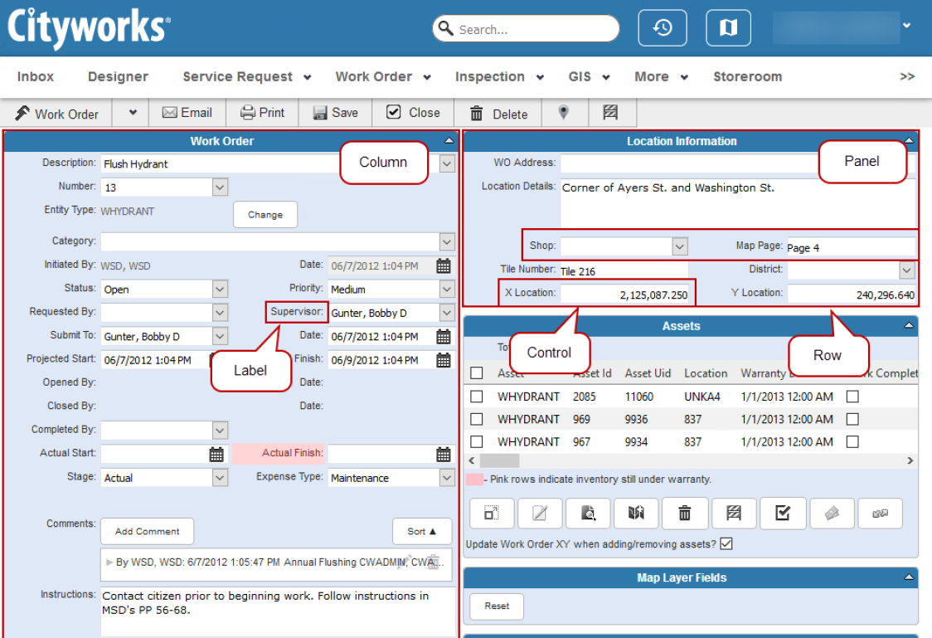
Layout

Slide 13
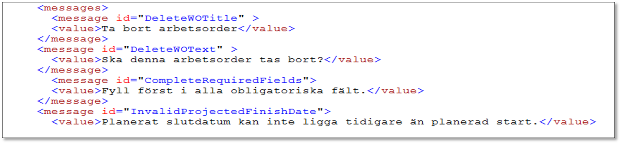
Messages
Generally used for internationalization and popup message customization.

Slide 14
Layout Manager
GUI-rendering engine responsible for roughly 90% of Cityworks UI.
Users cannot interact directly with Layout Manager, only through XML.
Layout Manager reloads the page dynamically each time the page is requested.
Process taken by Layout Manager:
Read XML Base File
Generate HTML
Read Custom XML
Edit HTML
Send HTML to Browser

Slide 15
Locating XML Files
XML files are located in the install directory
“…CWAdmin\<site name>\Website\Xml”
“Base” files should not be edited directly
“Non-Base” files can be modified directly
Always create a backup copy of non-Base files before editing

Slide 16
Editing XML
Any text editor should be able to load XML.
Text editors with IntelliSense are recommended
Visual Studio / Visual Studio Code
Notepad ++
Atom
Dozens more

